Slide 1
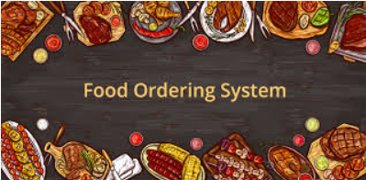
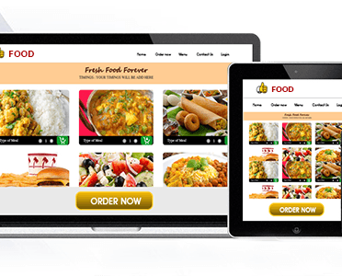
DATABASE MANAGEMENT SYSTEMS
TITLE: FOOD ORDERING SYSTEM
NAME:ABHIJIT MOHANTY
SRN:PES1201801293
SECTION : C

Slide 2
Overview
Many Restaurants is storing all of their data in manual way. They have huge number of customers daily, because of large number of customers, they need the help of some features so they can maintain and stores the records accurately. In the online food ordering system everything is handled by the admin that is the relation between the restaurants with customers and with the delivery person everything is in real time and efficient

Slide 3
Problem Statement
A online food ordering system need to store the information about customers(identified by the unique Cid and Cemail, their names, phone number, and their location where the food has to be delivered as attributes ),Restaurant(identified by unique Restaurant id(Rid) and email, Rname, Rphone and Rlocality), Orders(identified by the unique Orderid, totalprice and the number of items the customer bought from restaurant),Order contains Food(identified by unique id(Fid),name of the food(fname),Ftype,price and quantity)

Slide 4
Problem Statement
Food is delivered by an Employee(identified by unique id(Eid),Ename,Eage,Ephone) and Each Restaurant provide menu card from which customer can choose what they want to eat (it is identified by unique Foodid,Foodname,FoodType and FoodPrice).
Food belongs to only one particular hotel at a time.

Slide 5

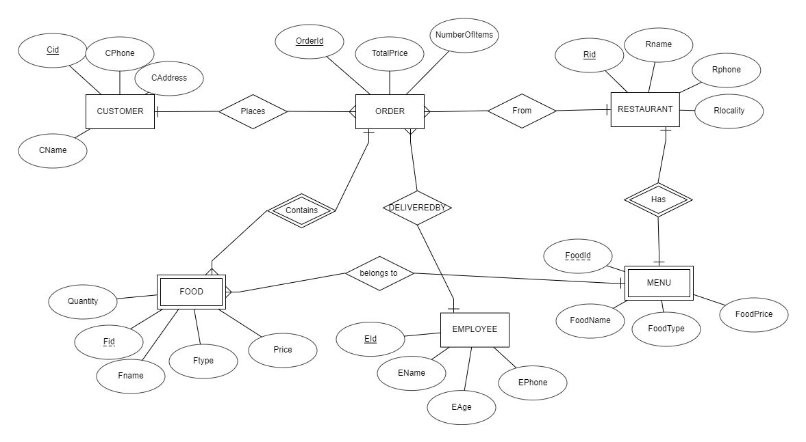
DATABASE SCHEMA

Slide 6
DATABASE SCHEMA
CUSTOMERS(Cid,Cphone,Caddress,Cname)
RESTAURANT(Rid,Rname,Rphone,Rlocality)
EMPLOYEE(Eid,Ename,EAge(age>=18),Ephone)
ORDERS (Orderid,TotalPrice,NumberOfitems,Cid(references to Customers),Rid(References to Restaurant),Eid(referenes to Employee))
FOOD(Fid,Orderid,Fname,Ftype,Price,Rid,FoodId,Quantity<5,Orderid(references Orders),(Rid,Foodid)references menu)
MENU (FoodId,Rid,FoodName,FoodType,FoodPrice,Rid(references Restaurant))

Slide 7
Functional Dependency
cid->{Cname,CEmail,Cphone,Caddress}
Cemail->{Cname,Cid,Cphone,Caddress}
{Cid,Cemail}->{Cname,Cphone,Caddress}
Rid->{Rname,Remail,Rhone,Rlocality}
Remail->{Rname,Rid,Rhone,Rlocality}
{Rid,Remail}->{Rhone,Rlocality}
{Fid,OrderId,FoodId,Rid}->{Fname,Ftype,Price,Quantity,OrderId}
Eid->{Ename,Eage,Ephone}
{FoodId,Rid}->{Foodname,FoodType,FoodPrice}
OrderId->{TotalPrice,NumberofItems,Cid,Rid,Eid}

Slide 8
Candidate Keys
Customer(Cid,Cemail){cid and Cemail are two different candidate keys}
We can see that Customer’s name,phone and address can be identified by a unique customer id or email because email is also unique for every person
Order(OrderId)
All the order details such who ordered, from where the ordered got placed and who delivered the order and what was ordered all these things can be uniquely identified by Orderid.
Restaurant(Rid,Remail)
We can see that Restaurant’s name,phone and locality can be identified by a unique Restaurant id or email because email is also unique for every person

Slide 9
Candidate Keys
Menu(Rid,FoodId){Rid and FoodId is a single candidate Key }
Both Rid and Foodid is a key because it’s obvious that a particular fooditem belongs to only that particular restaurant(Signature dishes) and therefore Menu is a weak entity set because without restaurant menu can’t exist for that restaurant.
Employee(Eid)
We can see that Employee’s name,phone and age can be identified by a unique Employee Id and we are not using email because it’s not necessary that all employees(Delivery Person ) may have a email.
Food(Fid,OrderId,FoodId,Rid)
The whole combination of Fid,OrderId,FoodId,Rid is a candidate and a primary key in this case because we know that Food is a weak entity set of Order(because without a ordered place there can’t be a food item belonging to any order) and Food also belongs to a particular hotel menu i.e you can’t order from different hotels at a time(constraint of my prblm).

Slide 10
Normalizations
cid->{Cname,Cphone,Cemail,Caddress}
Rid->{Rname,Rhone,Remail,Rlocality}
{Fid,OrderId,FoodId,Rid}->{Fname,Ftype,Price,Quantity}
Eid->{Ename,Eage,Ephone}
{FoodId,Rid}->{Foodname,FoodType,FoodPrice}
OrderId->{TotalPrice,NumberofItems,Cid,Rid,Eid}
All the functional dependency are in 3rd Normal Form as there is no multivalued attribute no partial key dependency and no transitive dependency therefore the resulting Relational model is same as our E-R Diagram.

Slide 11

How To Approach-1st Approach
According to the problem we know that we have to determine the functional dependency and then to create Entity sets and add respective key. Problem is straight forward but in the case of order contains food someone will think to make a relational model as
Order(orderid,FId,Totalprice,numberofitems,Fquantity,Fname,Ftype,Fprice), now we will try to analyze this and we will see how this will give us wrong answer.

Slide 12
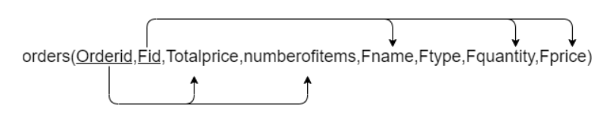
As you can see the functional dependency from the above diagram it violates or normalization forms. As we can see that the key is defined by combination of OrderId and Fid and the respective functional dependency is shown in the image now we see that it violates the 1st NF as well as 2nd NF(obviously as for 2NF we require 1NF) we see that a customer can order multiple food item and if we keep that with the orderEntity it will violate the rule for 1st NF and if somebody tells that he want only one food item to make it to 1st NF(which is wrong) but he will face another problem, which is violating the rule for 2nd NF i.e partial key dependency and therefore the solution to this is create two separate entity with a relationship between both order and Food.

Slide 13
Test For lossless Join
We Know That if we decompose relation into separate relations without testing the lossless join property then it may lead to the generation of spurious tuples on joining those decomposed relation therefore we have to test it(its most important in dbms perspective)
There are two tests we can perform one is using Successive NonAdditive Join Decomposition and another is easier that is do natural join on the decomposed relations and check with the original relation(this will be shown later).

Slide 14


FD:cid->{Cname,CEmail,Cphone,Caddress} (Example)
We will decompose customer table to two relation R1 and R2
R1:{cid,cname,cphone}
R2:{cid,cemail,caddress}
Original Matrix before start of Algorithm
Matrix After Applying Algorithm

Slide 15


FD:cid->{Cname,CEmail,Cphone,Caddress} (Example)
We will decompose customer table to two relation R1 and R2
R1:{cid,cname,cemail}
R2:{cemail,cphone,caddress}
Original Matrix before start of Algorithm
Matrix After Applying Algorithm

Slide 16
Restaurant(Rid,Rname,Rphone,Rlocality,foodidFoodnameFoodpriceFoodtype)
2)if we had table like Restaurant(Rid,Rname,Rphone,Rlocality,foodidFoodnameFoodpriceFoodtype)
We know that this is not in normalized form. Because we Rid and Foodid will be key and then there will be partial key dependency. Now we can divide the table making menu and restaurant as two table:
Menu(Rid,FoodId,Foodname,Foodprice,Foodtype)
Restaurant(Rid,Rname,Rphone,Rlocality)

Slide 17


TESTING FOR LOSSLESS JOIN
Rid->{Rname,Rlocality,Rphont,Foodid,Foodtype,Foodname,Foodprice}
Hence We can divide the tables into Menu and Restaurant(Menu is a weak entity set for Restaurant)
select * from menu NATURAL join restaurant where restaurant.rid=menu.rid

Slide 18
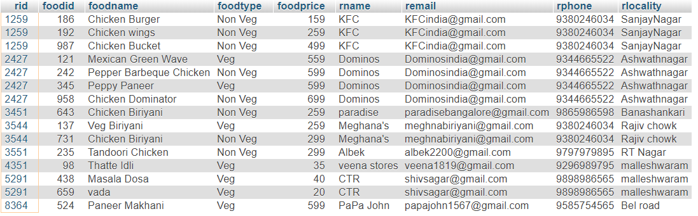

Slide 19
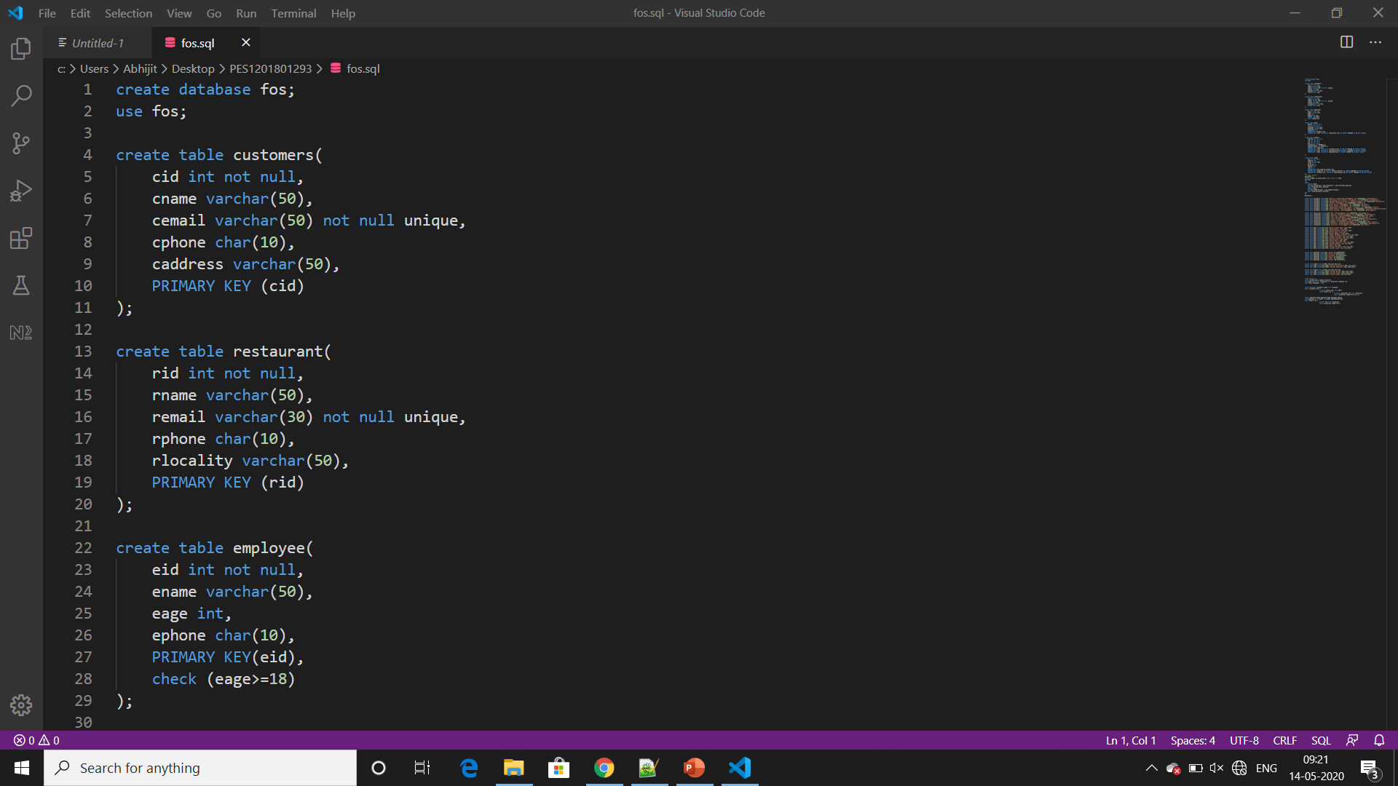
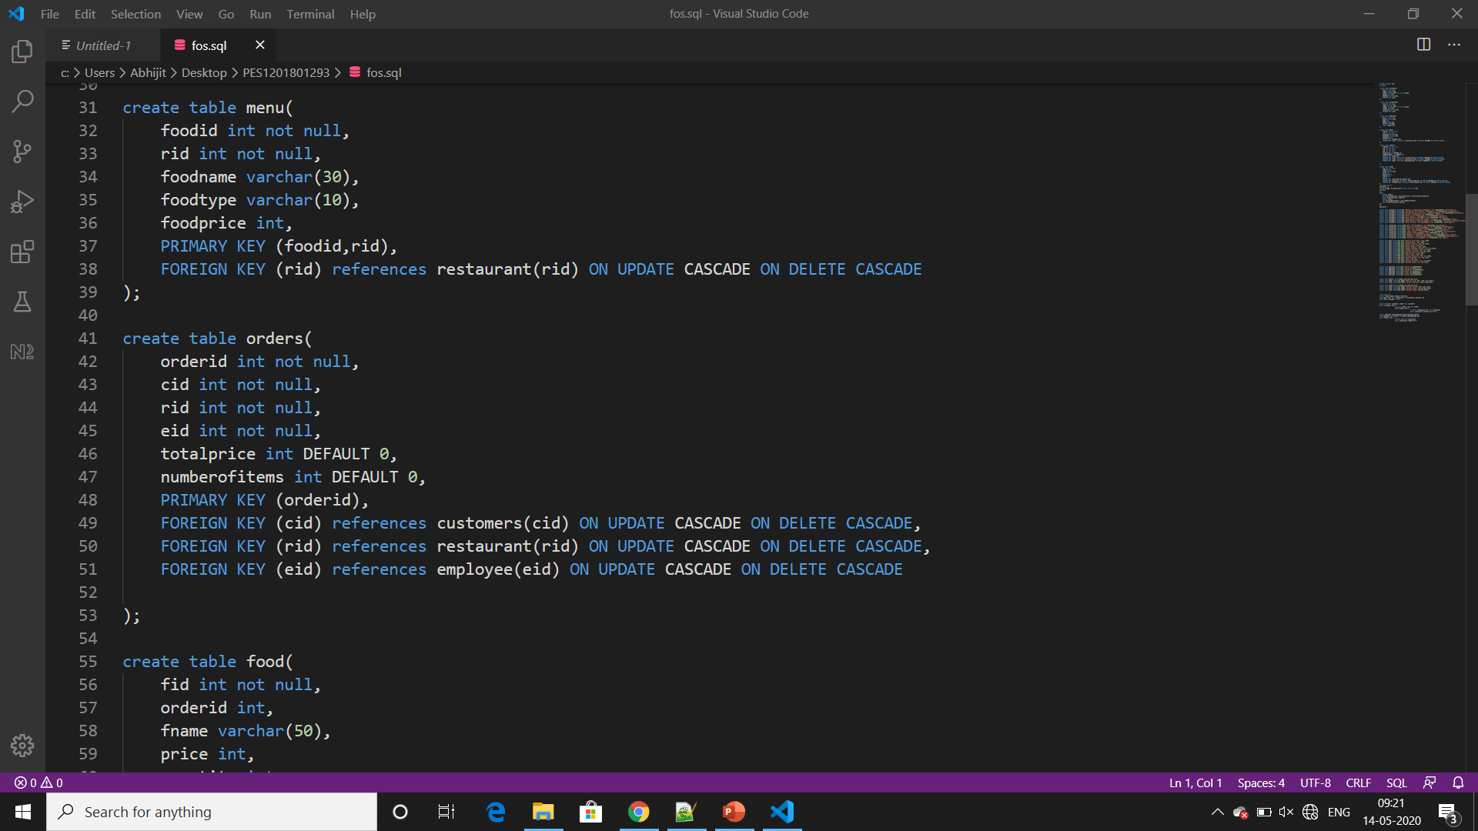
DDL:

Slide 20
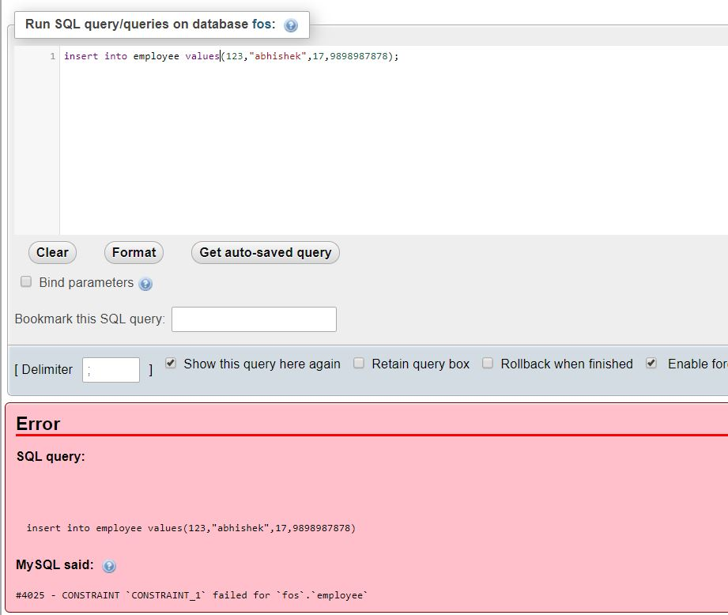
Creating Tables with check constraint
In mysql for check constraint I used alter table method i.e
Alter table employee add check eage>=18
Alter table food add check quantitiy <=5;

Slide 21
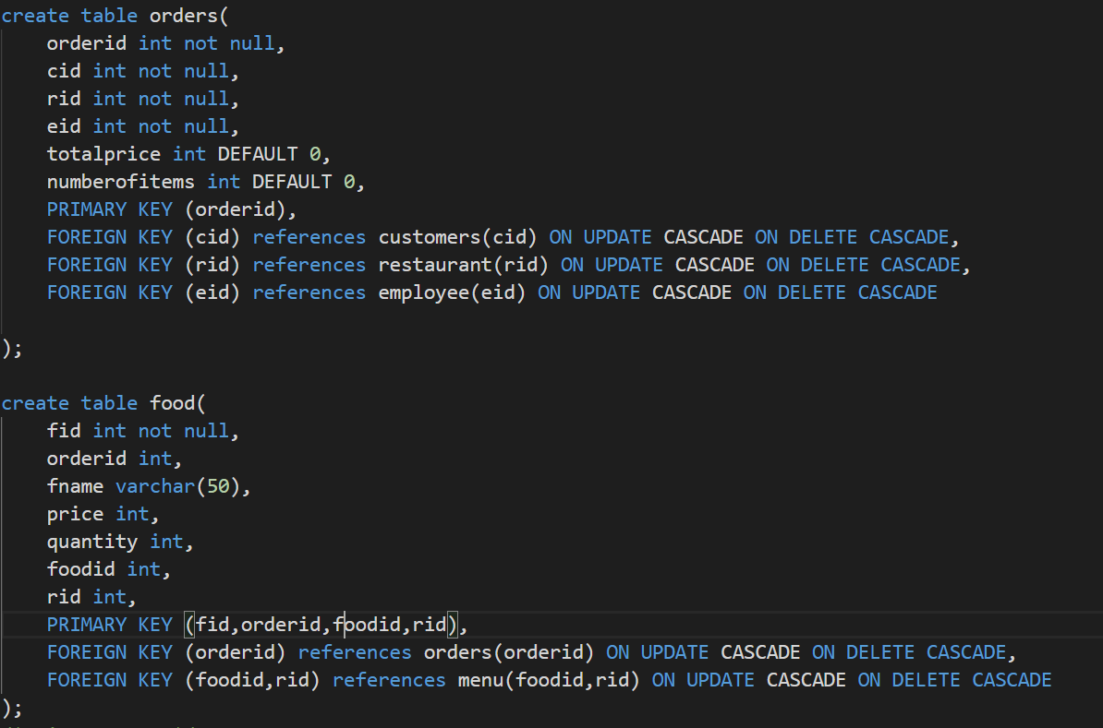
Creating referential integrity constraint
Foreign Key(referential integrity constraint

Slide 22
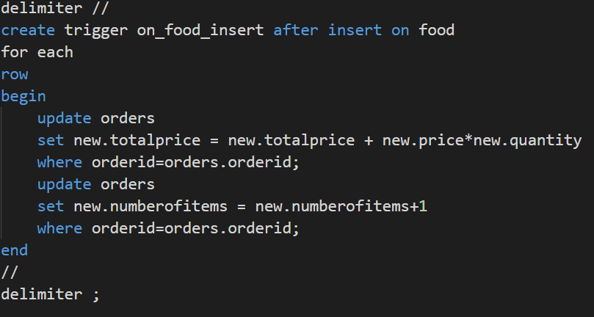
Creating A trigger
Trigger is used for automatic update in my project basically when a user enter the food item(in the food table) he wants the total price will be automatically be updated in the order table

Slide 23
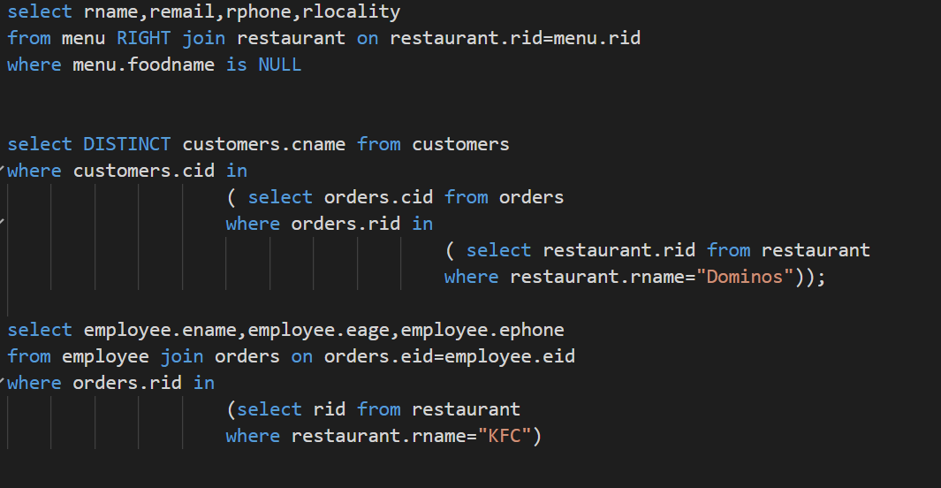
Complex SQL Retrieval Queries

Slide 24

TIME FOR DEMO

